Slide 1
Web GUI applications in the bank office channel – Mixing of session / customer data i browser windows
RedirectFacade
12.08.2015

Slide 2
Brief description of the problem
Most web GUI applications in EVRY FS office channel (Sales & Customer Service, Loan Process, Activity System, PEC, etc) has a problem regarding mixing of session data / customer data when multiple browser windows are started for a user on a PC.
Most system owners may not be aware of this problem in their web GUI applications, it is important that everyone checks this out and take action.
This issue has not been detected due to following reasons
Sharing session cookie among browser window was introduced in Internet Explorer 8
Sales & Customer Service and Loan Process application has previously been started from FD Front (FD Front always starts a new browser window in a new Internet Explorer session)
The user only starts one browser window
We have not found any solution for starting a new browser window in a new session programmatically from a web GUI application.

Slide 3

Brief description of the problem
User starts Loan Process from Sales & Customer Service, new browser window A with customer A is started.
User starts Loan Process again from Sales & Customer Service, new browser window B with customer B is started
If the user now switches to browser window A then this web browser window with Customer A will be overwritten with data for customer B.
Loan Process
- Browser window A
- Customer A
Sales & Customer Service
1
2
Loan Process-
- Browser window B
- Customer B

Slide 4
Short-term emergency solution introduced in Sales & Customer Service
Sales & Customer Service introduced a short-term emergency solution where Sales & Customer Service only starts one browser window for the different web GUI applications
Loan
Process
2
Sales & Customer Service
1
Activity
System
1
2
1
Appl. N
2
The user starts for example Loan Process from Sales & Customer Service
The user starts Loan Process again from Sales & Customer Service, Sales & Customer Service will now reuse the previous browser window used for Loan Process.

Slide 5
BUT the problem escalates further ….
The problem escalates further when more web GUI applications start other web GUI applications.
EEM – Logon / authentication
4
1
2
3
5
4
Sales & Customerservice
- Browser window A
- Customer A
Activity System
Sales & Customerservice
- Browser window D
- Customer D
3
2
3
5
Loan Process
- Browser window B
- Customer B
Loan Process
- Browser window C
- Customer C
Loan Process
- Browser window E
- Customer E

Slide 6
Further handling of the problem
EVRY FS Chief Architect Group has decided that each application is responsible must address and solve the problem regarding mixing sessions data.
The Sales & Customer Service projects has chosen to address this challenge with a "Redirect facade“ solution. A possible rewrite to handle multiple browser windows has been considered too expensive to implement.
The concept of "Redirect facade" implemented by Sales & Customer should be reused for other applications.

Slide 7
Description of «Redirect Facade» in Sales and Customer Service
Sales & Customer Service is started via Sales & Customer Service «Redirect Facade»
Sales & Customer Service «Redirect Facade» has following responsibilties (tasks):
Ensure that the mixture of session data does not occur by allowing only one browser window to be started
In addition, the following functionality is added in Sales & Customer Service application :
Control the appearance of the browser window to be started (windows size, start without browser menu and navigations, etc.)
Start Sales & Customer Service pilot or production instance based on users EAM authorization role
«Redirect Facade» uses Java scripts «windows.open»
"Redirect Facade" starts new SCS browser window with a predefined name using "windows.open»
"Windows.open» reuses existing named browser window if already started, and control the appearance of the browser window (window size, start without browser menus and navigation buttons, etc)

Slide 8
Naming regime for browser windows
Following naming regime must be followed to avoid naming collisions among several applications:
<System Short Name><ApplId>Wnd
Where <ApplId> is optional and used if the system offers more than one client
Example 1 – System offers only one client:
Sales & Customer Service application: scsWnd
Example 2 – System offers more than one client
Card Administration System (CAS): casClient1Wnd and casClient2Wnd

Slide 9
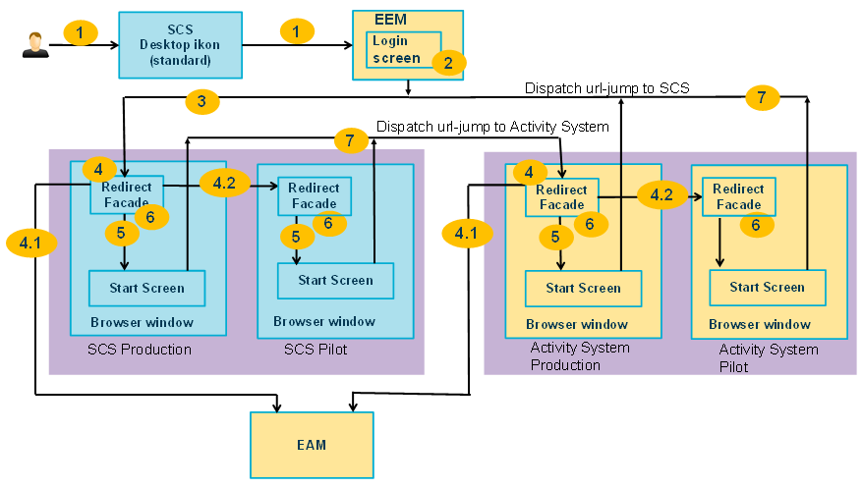
Flow description of «Redirect Facade» in Sales & Customer Service
1. User clicks on SCS desktop icon that contains the command to start SCS via EEM login screen. 2. EEM shows the authentication screen, user enters a username and password. 3. After successful authentication, EEM starts SCS Redirect Facade with EVRY SO supplied as a POST parameter. 4. Redirect Facade handling 4. 1. Checks whether pilot or production instance shall be used, based on the user EAM authorization role. 4.2 If EAM pilot authorization role then redirect to pilot environment Redirect Facade. 5. Redirect Facade executes window.open. 6. Redirect Facade browser window closes itself. 7. Users starts Activity System Client from SCS or Activity System Clients starts SCS.

Slide 10
Questions & help ?
RedirectFacade
Contact :
The Domain Architect in your BU (Business Unit)
See FSWIKI presentation of Architecture Roles
The Sale & Customer architect :
Geir.hestholm@evry.com
The cheif architect group
ArchitecturesupportFS@evry.com

